Slide 1


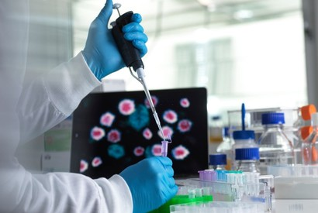
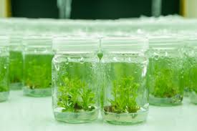
Department of M.Sc Biotechnology
The Department of Biotechnology (PG) has established in 2006. As a pioneer in the state, quickly gaining popularity within the Academy due to the vast opportunities to both students and faculty. The department draws its strength from a highly qualified team of faculty members with doctoral and post-doctoral credentials, and extensive experience in academics, research, and industry. Renowned professors and visiting scientists contribute to a wide range of research areas, including green synthesis of nanoparticles, antimicrobial and anticancer studies, bio-fuels, bioremediation, wastewater treatment, biomedical research, genomics and proteomics, bioinformatics, and agricultural biotechnology. The department boasts six well-equipped laboratories catering to various subject areas, a research center of international standards, and a bioinformatics facility featuring state-of-the-art molecular modeling and drug design software. Advanced equipment such as a 3L fermenter and RT-PCR further strengthen the department’s research capabilities. The department also takes pride in its active collaboration with industry partners in filing patents and intellectual property
VISION :
To impart higher education with integral formation focused on infusing together Biology, Engineering, and Technology for holistic development.
.MISSION :
To integrate innovative practices in skill-based learning through involvement in Biotechnology to Mould Students Into “Future Biotechnologists” & to be socially Responsible Citizens
PROGRAMS OFFERED
MSc.Biotechnology highlights:
Cell Biology,Microbiology Genetics, Animal Biotechnology
Bioprocess engineering,
Plant Biotechnology,
Nano biotechnology, Immunology, Bioinformtics ,Molecular biology and Medical Biotechnology
CAREER OPPORTUNITIES:
Our students are placed in various prestigious companies and industry/Institutes such as CCMB, CDFD, Lacones, Hyderabad Central University, A.P Forensic Sciences, Dr. Reddy’s Research Laboratory, Shantha Biotechniques, Bharath Biotech, Indian Immunological, Reliance Life Sciences, ICRISAT, IIMR, CRIDA, Prathista Biotech Pvt. Ltd., etc.
WHY LOYOLA ACADEMY?
NAAC Accredited and recognized for academic excellence.
Strong industry collaborations ensuring top-notch placements.
Innovation-driven approach with a focus on emerging technologies.
HIGHER EDUCATION PROSPECTS:
Admission into Ph.D in national and international universities/ Institutes
DEPARTMENT HIGHLIGHTS
6 laboratories with state of art facilities
1 research lab with high end equipment like HPLC,ELISA,UV-VIS Spectrometer with double beam, PCR,RT-PCR, Inverted Microscope and fermenter.
Students are encouraged to do in house and External research projects in notational and International Institutes.
Faculty with post-doctoral and doctoral degrees with academic, research and industry expertise.
ADMISSION GUIDELINES:
30 seats through TSCPGET and 6 seats by College management

Slide 2
















M.Sc., Biotechnology
SEM 1
SEM 2
SEM 3
SEM 4
Genetics
Cell Biology
Micro Biology
Environ mental Biotechnology
Bio Chemistry
Communicative competence
Computer Applications
Environmental Awareness Activity
Immunology
Molecular Biology-I
Molecular Biology –II
R-DNA Technology
Human Values and Professional Ethics
Biostatics and Research Methodology
Plant and Agricultural Biotechnology
Animal Biotechnology
Medical Biotechnology
Bioinformatics
Bioprocess Engineering
Nano biotechnology
Food Biotechnology
Project
EXTRA CURRICULAR ACTIVITIES
STUDENT SUPPORT
NON-CGPA COURSES
STUDENT CENTRIC METHODS
Sports
Resonance
Academic counseling
Generic Electives
Mentoring
Self study
Add-on course
Planet NPTEL Bridge Course
Industrial Visits
Minor Projects
Internships
Research Papers Poster
Presentations Group
Discussions/Seminars/
Debate

